Slide 1
High-Resolution Image Synthesis with Latent Diffusion Models
CVPR 2022
Robin Rombach, Andreas Blattmann, Dominik Lorenz, Patrick Esser, Björn Ommer
Presented by Beomsoon Park
C&I LAB

Slide 2
Contents
Introduction
Related Works
Method
Experiments
C&I LAB

Slide 3
Introduction
C&I LAB

Slide 4
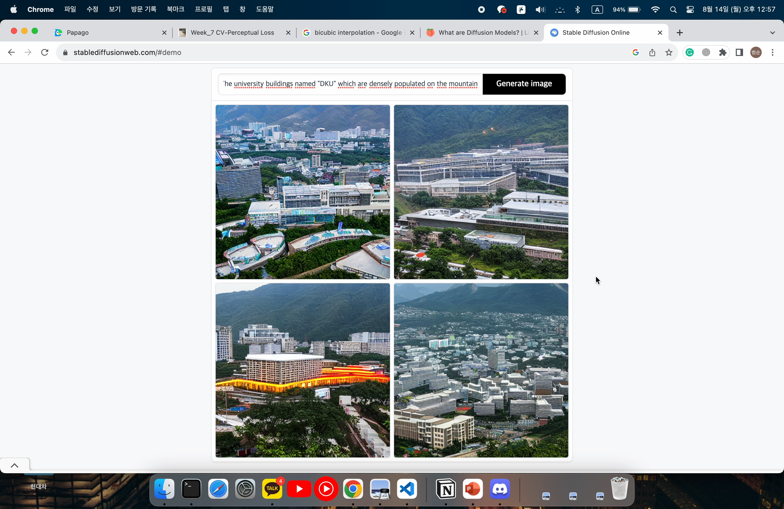
Introduction
Stable Diffusion
Text Prompt
The university buildings named “DKU” which are densely populated on the mountain
https://stablediffusionweb.com/#demo
C&I LAB

Slide 5
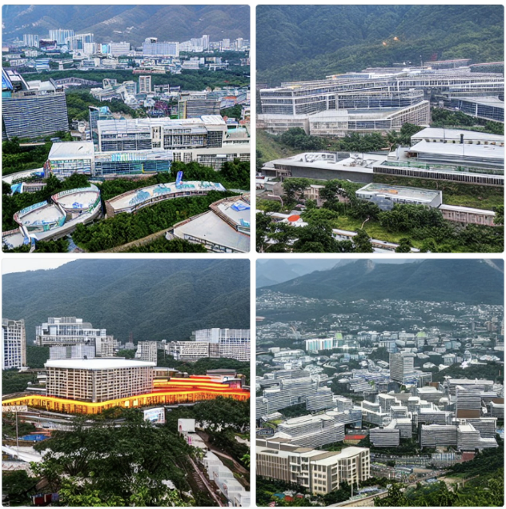
Introduction
Stable Diffusion
(Text Encoder)
Pretrained CLIP ViT-L/14
Text Prompt
The university buildings named “DKU” which are densely populated on the mountain
Latent Diffusion Model
(LDM)
https://stablediffusionweb.com/#demo
C&I LAB

Slide 6
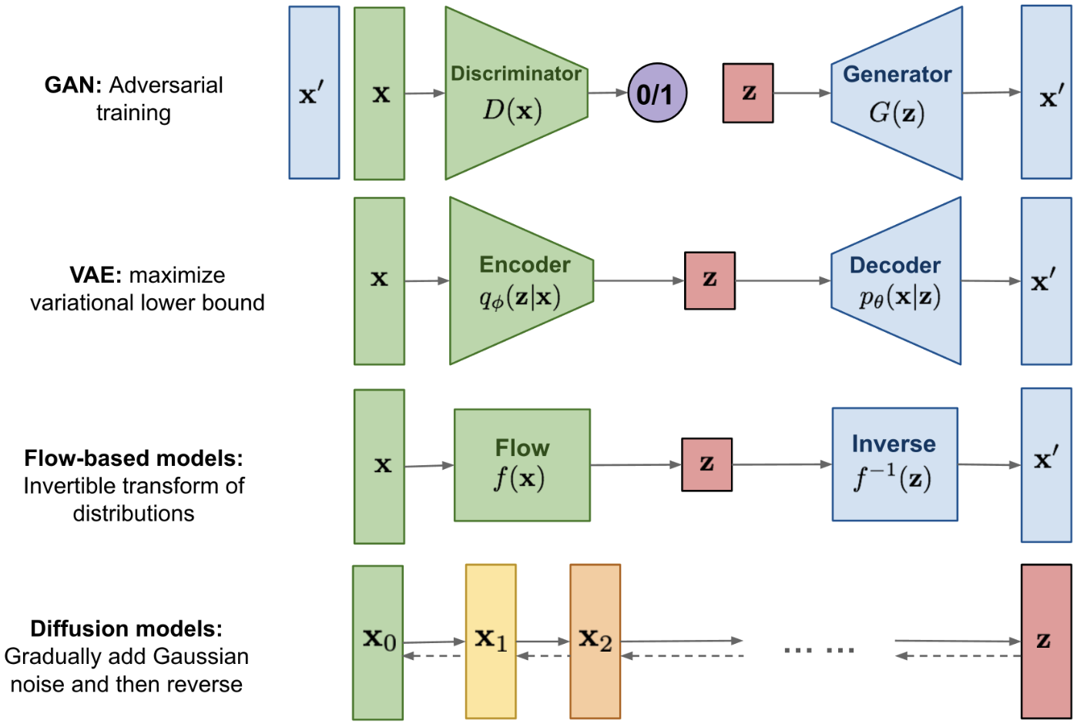
Introduction
Generative Models
Latent Diffusion Model
(LDM)
https://lilianweng.github.io/posts/2021-07-11-diffusion-models/
C&I LAB

Slide 7
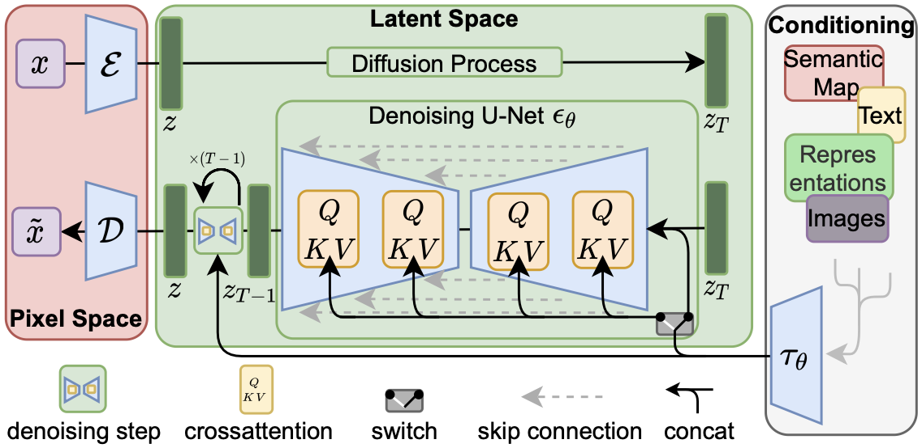
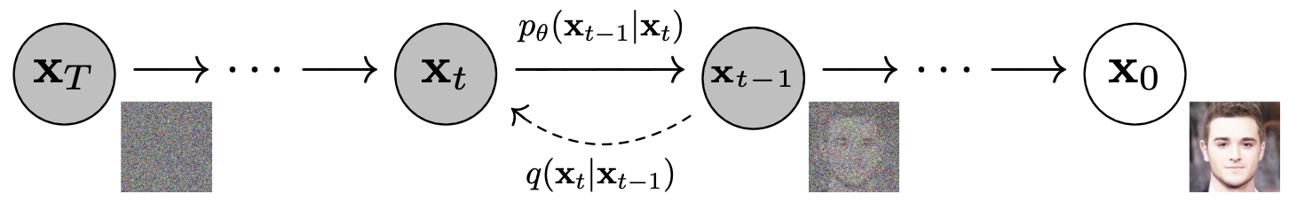
Introduction
Contribution
(LDM)
Latent Diffusion Model
(DDPM)
Previous Diffusion Models
Pixel-based Computation
→ Massive computational requirement
→ Expensive Training, Evaluation, Inference
→ Slow sampling
(50K sampling for 5 days on a single A100 GPU)
Computation on low-dimensional space
→ Less computational complexity
→ Enhance accessibility
https://lilianweng.github.io/posts/2021-07-11-diffusion-models/
C&I LAB

Slide 8
Related Works
C&I LAB

Slide 9
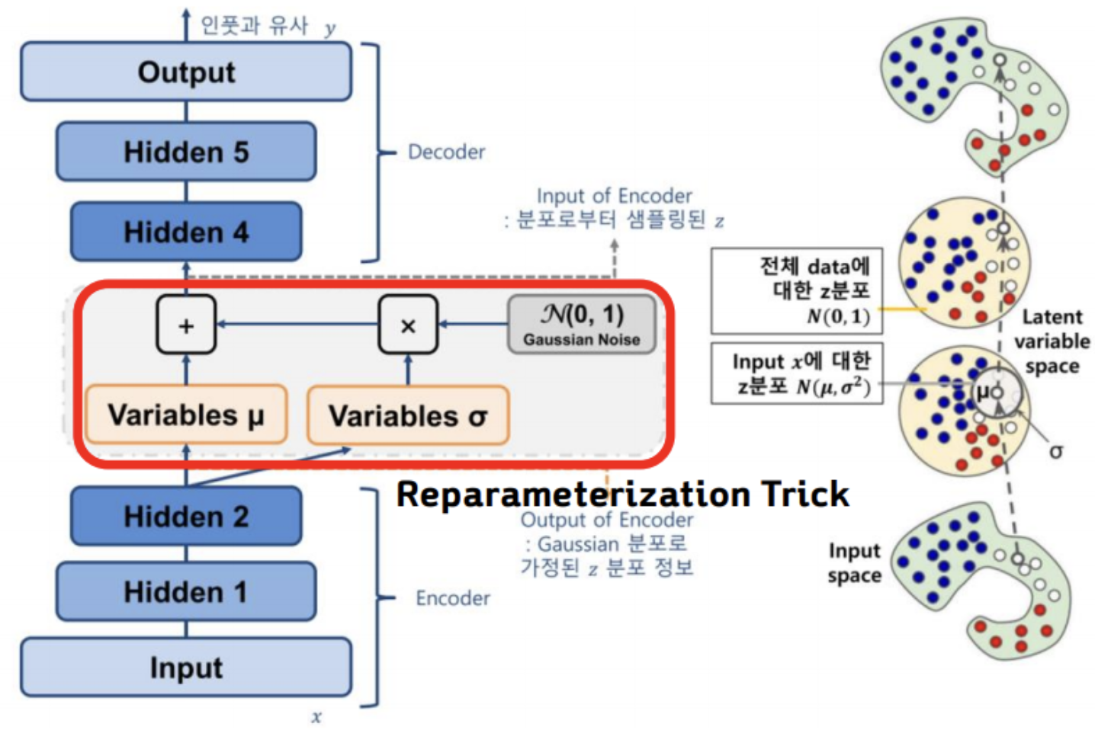
Related Works
VAE
Regularization Term (KL-reg)
Reconstruction Term
https://bigdata-analyst.tistory.com/349
C&I LAB

Slide 10
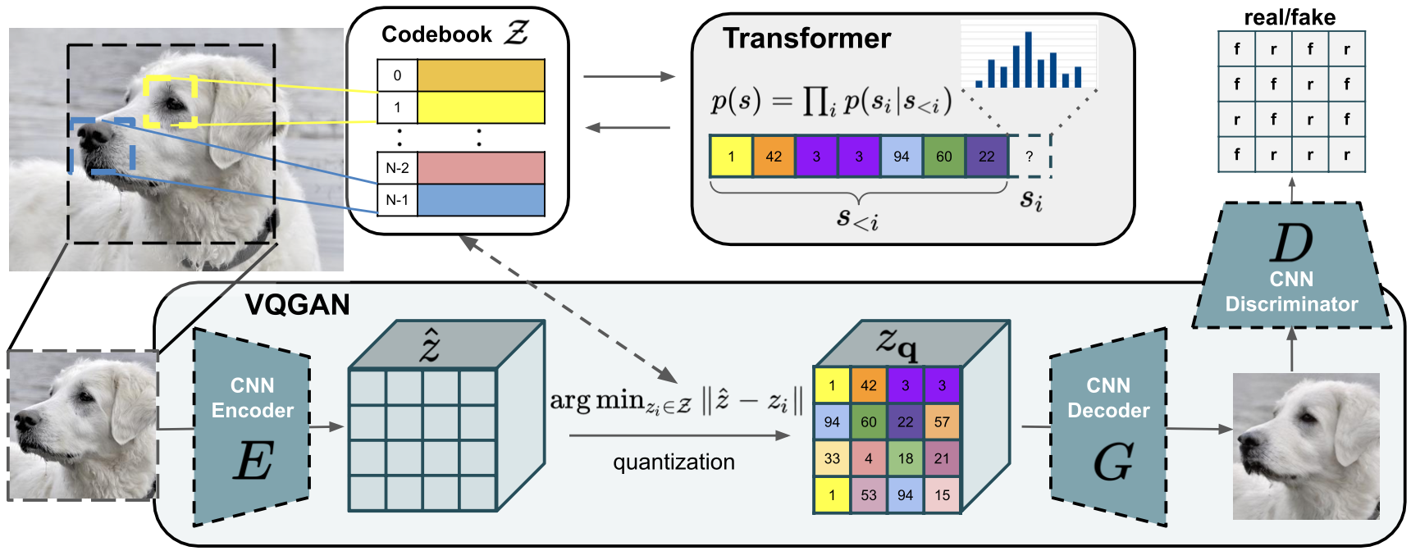
Related Works
VQGAN (Vector Quantization) - VQ regularization
(Decoder Training)
1st Term
: Reconstruction Term
2nd Term
Discrete Latent Space
3rd Term
: Commitment Term
(Encoder Training)
VQ-reg : $ℒ_{VQ}\left(E,G,𝒵\right)={\left\|x−\hat{x}\right\|}^{2}+{\left\|sg\left[E\left(x\right)\right]−z_{q}\right\|}_{2}^{2}+{\left\|sg\left[z_{q}\right]−E(x)\right\|}_{2}^{2}$
(${\left\|.\right\|}_{2}^{2}$ : Perceptual Loss)
C&I LAB

Slide 11
Related Works
VQGAN (Vector Quantization) – 2-stage Image Synthesis
High Compression Rate
Low Compression Rate
Feasible for ARM training, Billions of parameters required
Less parameters to train, Expensive Computation for ARM training
Autoregressive Model
C&I LAB

Slide 12
Related Works
DDPM
Forward vs Reverse
Direct Computation
on high-dimensional data space
Slow Inference
on the same dimensional space
C&I LAB

Slide 13
Method
C&I LAB

Slide 14
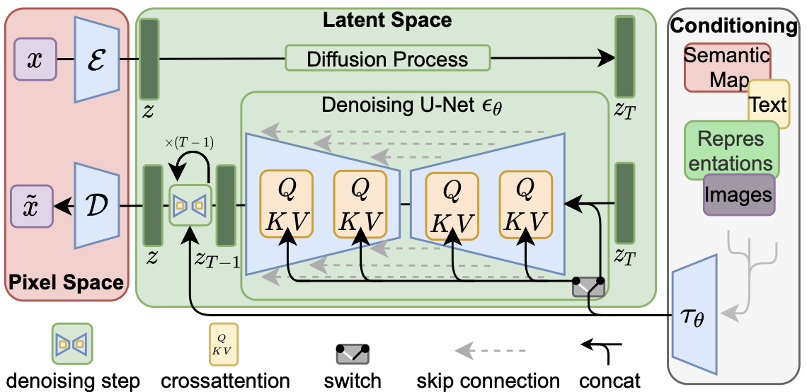
Method
Latent Diffusion Model
C&I LAB

Slide 15
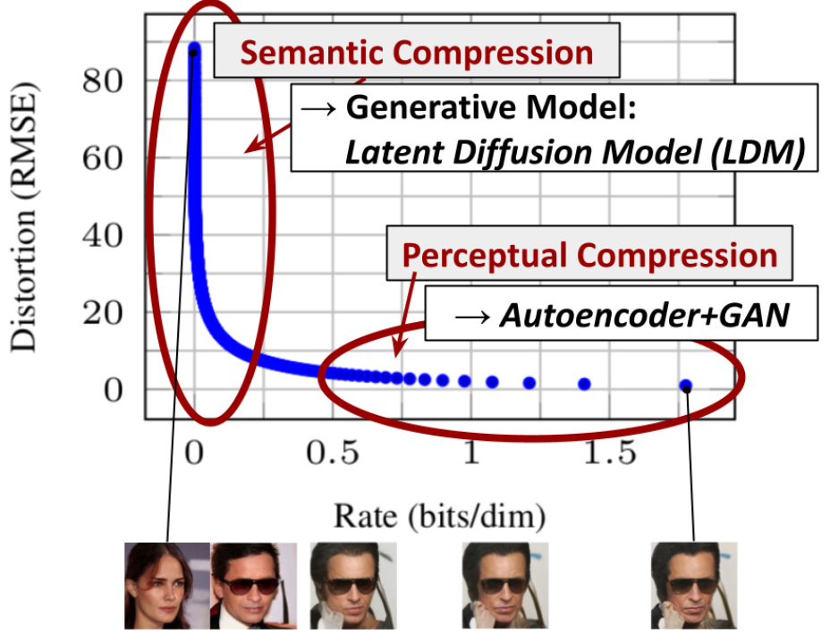
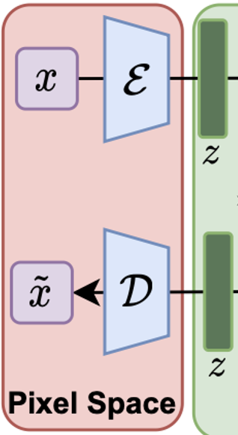
Method
Handle meaningful features directly
Perceptual Compression Model
Purpose of training autoencoder
Find low dimensional latent space that is perceptually equivalent to image space
Support efficient DM training by removing semantically irrelevant features which are described in pixel space
Mild compression rate is admitted
→ Minimize image quality reduction
Meaningless features are dealt with Autoencoder+GAN
C&I LAB

Slide 16
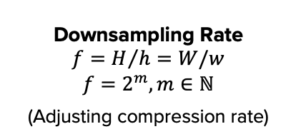
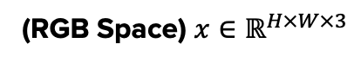
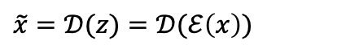
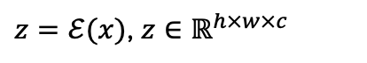
Method
Perceptual Compression Model
(RGB Space) $x∈ℝ^{H×W×3}$
$z=ℰ(x)$, $z∈ℝ^{h×w×c}$
Downsampling Rate
$$f=H/h=W/w$$
$$f=2^{m}, m∈ℕ$$
(Adjusting compression rate)
$$\tilde{x}=𝒟(z)=𝒟(ℰ\left(x\right))$$
C&I LAB

Slide 17
Method
Perceptual Compression Model
Perceptual Loss + Patch-based Adversarial Loss
Reconstruction Loss
Adversarial
Loss
Patch-based Discriminator Term
Regularization Term
Avoiding arbitrarily high-variance latent space
Only discriminator is extracted from VQGAN
C&I LAB

Slide 18

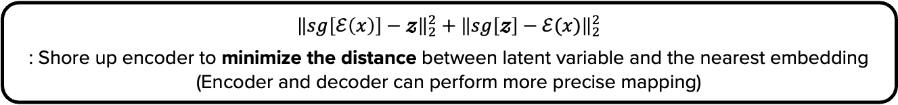
Method
Regularization Term
KL-regularization (VAE)
$KL(q_{ℰ}(x|z)||p(z))$ → $q_{ℰ}\left(x | z\right) \sim 𝒩(z;ℰ_{μ},ℰ_{σ})$, $p\left(z\right) \sim 𝒩\left(z;0,𝕀\right)$
: Train encoder to make latent space centered zero with smooth continuity
(Avoid reconstructing irrelevant feature)
VQ-regularization (VQGAN)
$${\left\|sg\left[ℰ\left(x\right)\right]−𝔃\right\|}_{2}^{2}+{\left\|sg\left[𝔃\right]−ℰ(x)\right\|}_{2}^{2}$$
: Shore up encoder to minimize the distance between latent variable and the nearest embedding
(Encoder and decoder can perform more precise mapping)
C&I LAB

Slide 19
Method
Regularization Term
KL-regularization (VAE)
$KL(q_{ℰ}(x|z)||p(z))$ → $q_{ℰ}\left(x | z\right) \sim 𝒩(z;ℰ_{μ},ℰ_{σ})$, $p\left(z\right) \sim 𝒩\left(z;0,𝕀\right)$
: Train encoder to make latent space centered zero with smooth continuity
(Avoid reconstructing irrelevant feature)
Improvement
Train autoencoder to produce meaningful latent space retaining information in pixel space with reduced dimensionality
→ It is possible to perform mild compression preventing image quality reduction
VQ-regularization (VQGAN)
$${\left\|sg\left[ℰ\left(x\right)\right]−𝔃\right\|}_{2}^{2}+{\left\|sg\left[𝔃\right]−ℰ(x)\right\|}_{2}^{2}$$
: Shore up encoder to minimize the distance between latent variable and the nearest embedding
(Encoder and decoder can perform more precise mapping)
C&I LAB

Slide 20
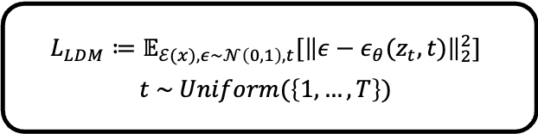
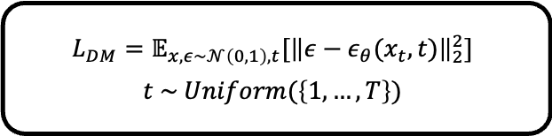
Method
Diffusion Model in latent space
DDPM
(Training)
Forward Markov Process
$$L_{DM}=𝔼_{x,ε\sim 𝒩\left(0,1\right),t}[{\left\|ε−ε_{θ}(x_{t},t)\right\|}_{2}^{2}]$$
$$t \sim Uniform(\left\{1,…,T\right\})$$
LDM
$$L_{LDM}≔𝔼_{ℰ(x),ε\sim 𝒩\left(0,1\right),t}[{\left\|ε−ε_{θ}(z_{t},t)\right\|}_{2}^{2}]$$
$$t \sim Uniform(\left\{1,…,T\right\})$$
Reverse Markov Process
(Sampling)
Replaceable with DDIM sampler
C&I LAB

Slide 21
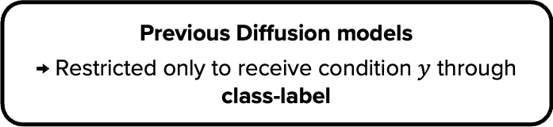
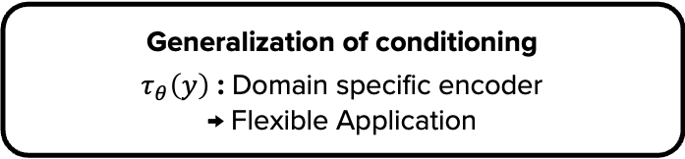
Method
Conditioning Mechanisms
Previous Diffusion models
→ Restricted only to receive condition $y$ through class-label
Generalization of conditioning
$τ_{θ}\left(y\right)$ : Domain specific encoder
→ Flexible Application
C&I LAB

Slide 22
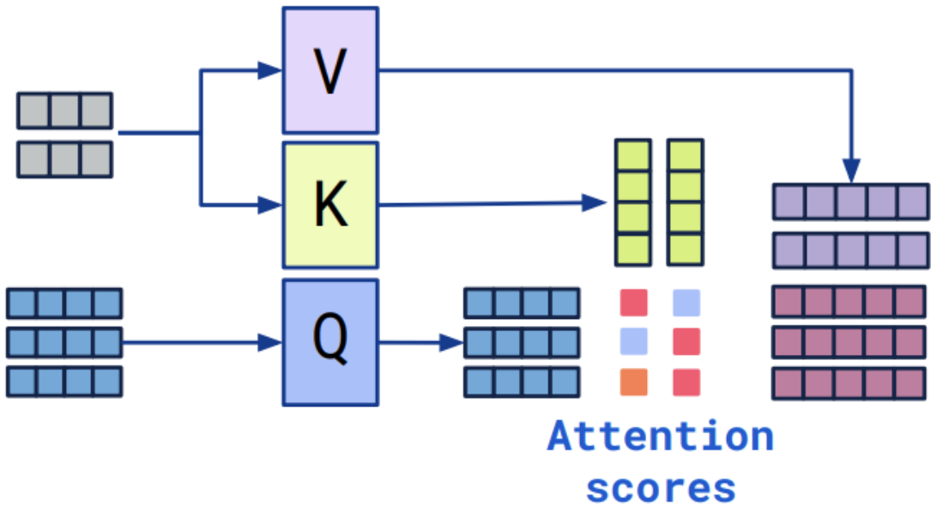
Method
Conditioning Mechanisms
Conditional sampling
“Cross Attention”
Applying information in a sequence to another sequence
C&I LAB

Slide 23
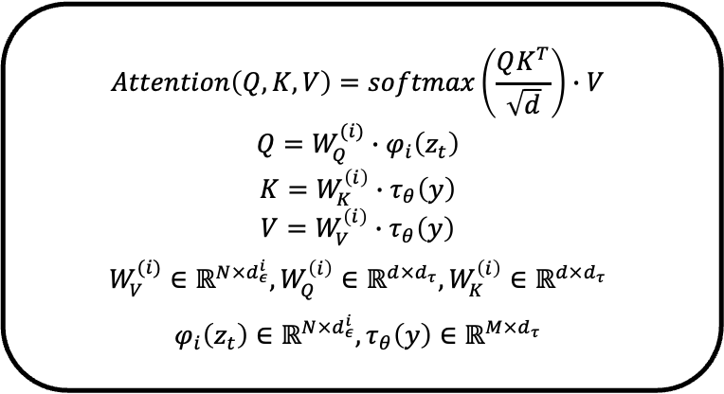
Method
Conditioning Mechanisms
Conditional sampling
“Cross Attention”
$$Attention\left(Q,K,V\right)=softmax\left(\frac{QK^{T}}{\sqrt{d}}\right)∙V$$
$$Q=W_{Q}^{(i)}∙φ_{i}\left(z_{t}\right)$$
$$K=W_{K}^{\left(i\right)}∙τ_{θ}\left(y\right)$$
$$V=W_{V}^{\left(i\right)}∙τ_{θ}\left(y\right)$$
$$W_{V}^{(i)}∈ℝ^{N×d_{ε}^{i}},W_{Q}^{\left(i\right)}∈ℝ^{d×d_{τ}},W_{K}^{\left(i\right)}∈ℝ^{d×d_{τ}}$$
$$φ_{i}\left(z_{t}\right)∈ℝ^{N×d_{ε}^{i}},τ_{θ}\left(y\right)∈ℝ^{M×d_{τ}}$$
(Noisy Data) Query
(Condition)
Key, Value
C&I LAB

Slide 24
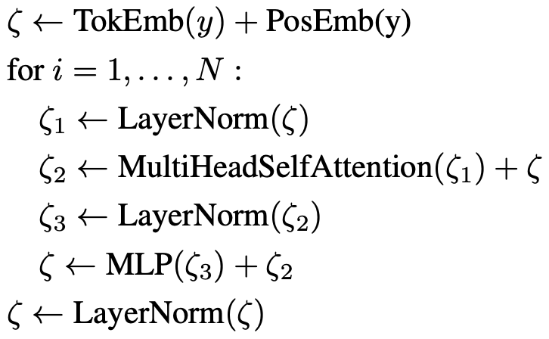
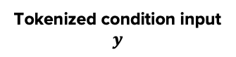
Method
Conditioning Mechanisms
Conditional sampling
1
“Denoising U-Net + Cross Attention”
Tokenized condition input $y$
Similar to unmasked Transformer decoder
C&I LAB

Slide 25
Method
Conditioning Mechanisms
Conditional sampling
2
“Denoising U-Net + Cross Attention”
Previous U-Net Model : ADM (Ablated Diffusion Model)
→ Self-Attention applied to 4X4, 8X8, 16X16 resolutions
Suggested U-Net Model
→ Self-Attention Layer + point-wise MLP + Cross-Attention Layer
C&I LAB

Slide 26
Method
Conditioning Mechanisms
Conditional sampling
2
“Denoising U-Net + Cross Attention”
Suggested U-Net Model
→ Self-Attention Layer + point-wise MLP + Cross-Attention Layer
Local realism (Skip Connection)
+
Global effect (Attention Mechanism)
C&I LAB

Slide 27
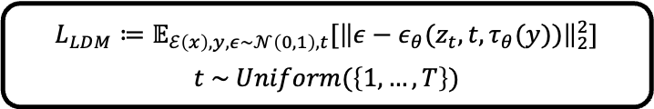
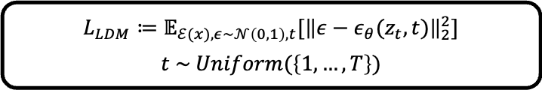
Method
Conditioning Mechanisms
Conditional sampling
“Objective Function in Conditional Model”
$$L_{LDM}≔𝔼_{ℰ(x),ε\sim 𝒩\left(0,1\right),t}[{\left\|ε−ε_{θ}(z_{t},t)\right\|}_{2}^{2}]$$
$$t \sim Uniform(\left\{1,…,T\right\})$$
$$L_{LDM}≔𝔼_{ℰ\left(x\right),y,ε\sim 𝒩\left(0,1\right),t}[{\left\|ε−ε_{θ}(z_{t},t,τ_{θ}(y))\right\|}_{2}^{2}]$$
$$t \sim Uniform(\left\{1,…,T\right\})$$
C&I LAB

Slide 28
Experiments
C&I LAB

Slide 29
Experiments
Various Experiments
Perceptual
Compression
Tradeoffs
Latent Diffusion Model Performance
Conditional Image Generation
Super-Resolution
Inpainting
C&I LAB

Slide 30
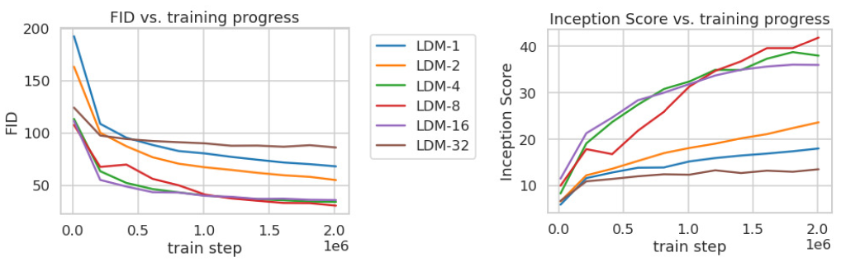
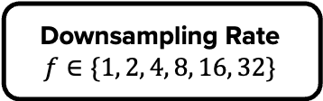
Experiments
Perceptual Compression Tradeoffs
Downsampling Rate
$$f∈\{1, 2, 4, 8, 16, 32\}$$
Training Efficiency Evaluation
Slow Training Progress
Class-conditional model training with 2M training steps on ImageNet dataset
Good balance between efficiency and quality from LDM-4, LDM-8, LDM-16
C&I LAB

Slide 31
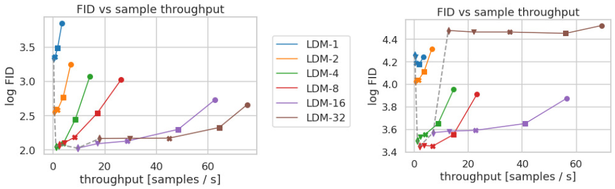
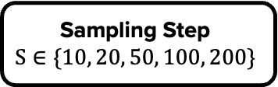
Experiments
Perceptual Compression Tradeoffs
Sampling Step
$$S∈\{10, 20, 50, 100, 200\}$$
Sampling Efficiency Evaluation with DDIM sampler
LDM-1, 2, 16, 32
→ Unsuitable ratio of perceptual and conceptual compression
(Bad performance)
5000 samples
after 500K Training (CelebA)
5000 samples
after 2M Training (ImageNet)
Best performance from LDM-4, LDM-8
C&I LAB

Slide 32
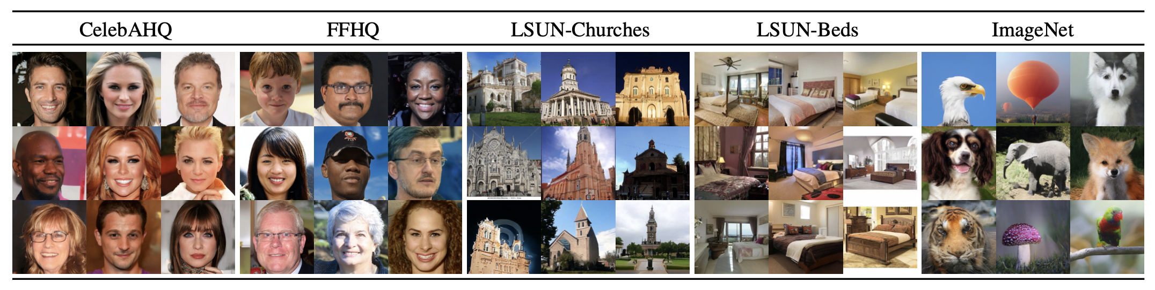
Experiments
Latent Diffusion Model Performance
Samples from LDMs trained with different datasets
C&I LAB

Slide 33
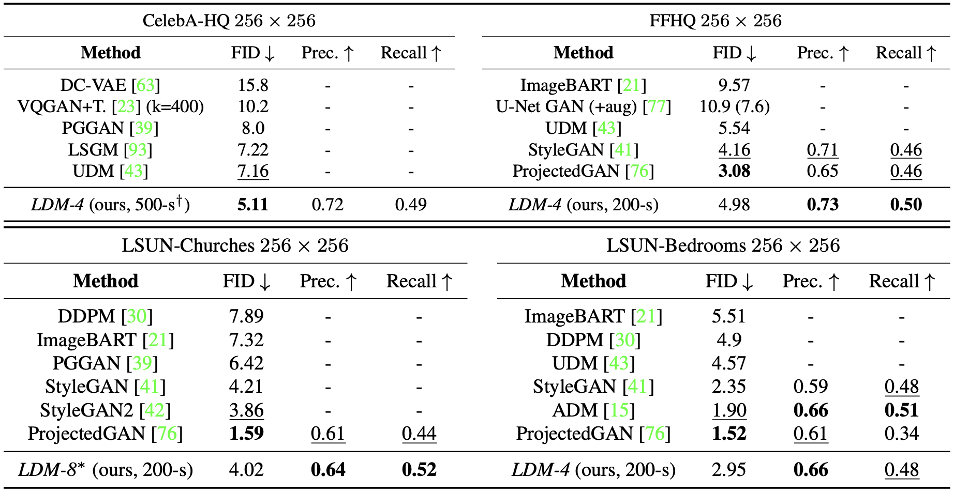
Experiments
Latent Diffusion Model Performance
(Others : VQ-reg)
KL-regularized
LDM
C&I LAB

Slide 34
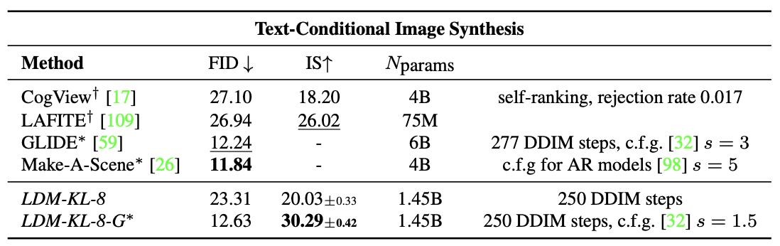
Experiments
Conditional Latent Diffusion (Text-to-Image)
(Text)
Text Prompt → BERT-tokenizer → $τ_{θ}$ (Transformer Encoder)
(Image)
LDM with 1.45B parameters trained on LAION-400M dataset
C&I LAB

Slide 35
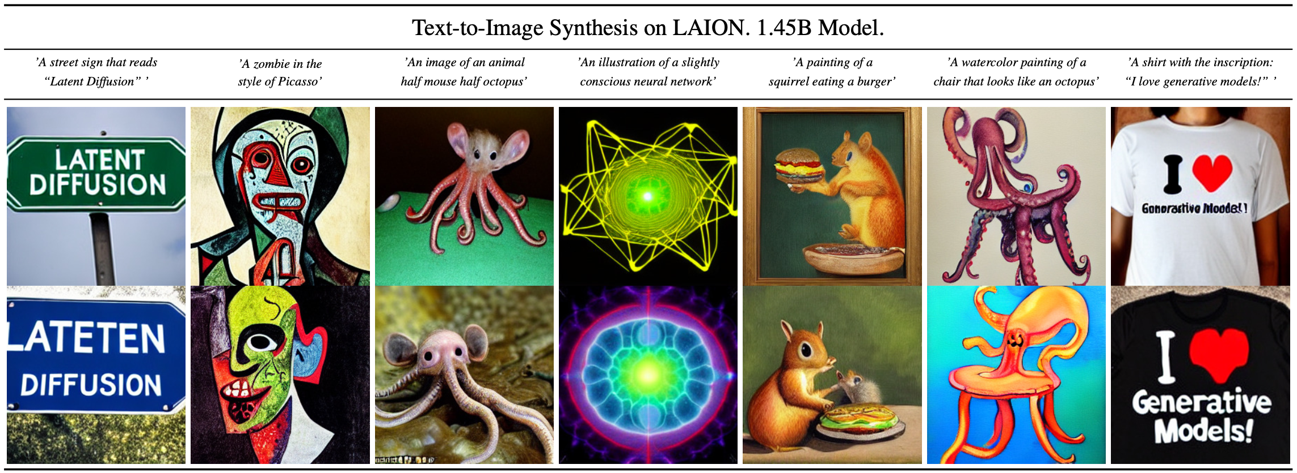
Experiments
Conditional Latent Diffusion (Text-to-Image)
200 DDIM sampling step
+ Unconditional guidance s = 10.0
C&I LAB

Slide 36
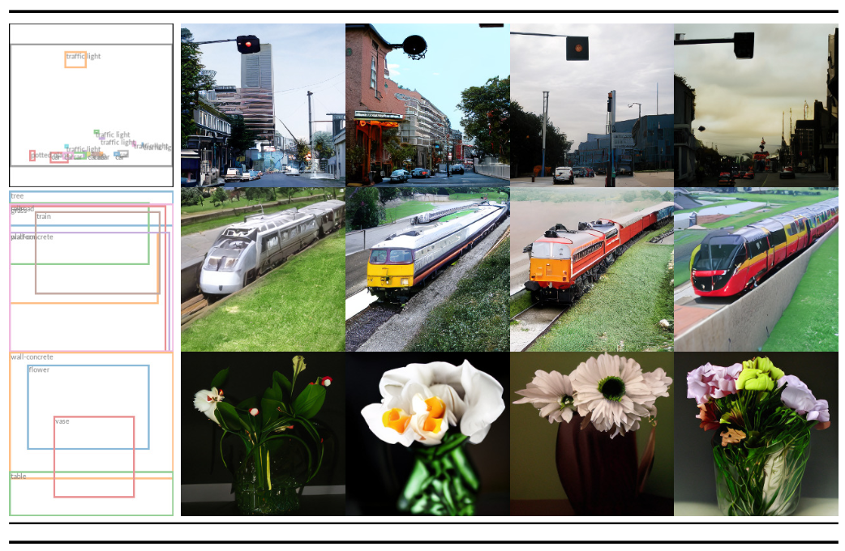
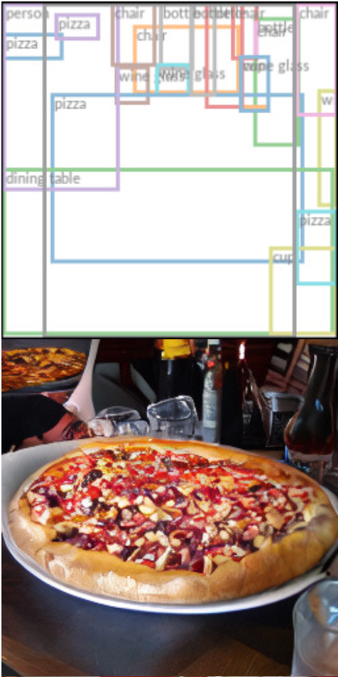
Experiments
Conditional Latent Diffusion (Layout-to-Image)
Semantic Layout
Conditionally Generated Image
C&I LAB

Slide 37
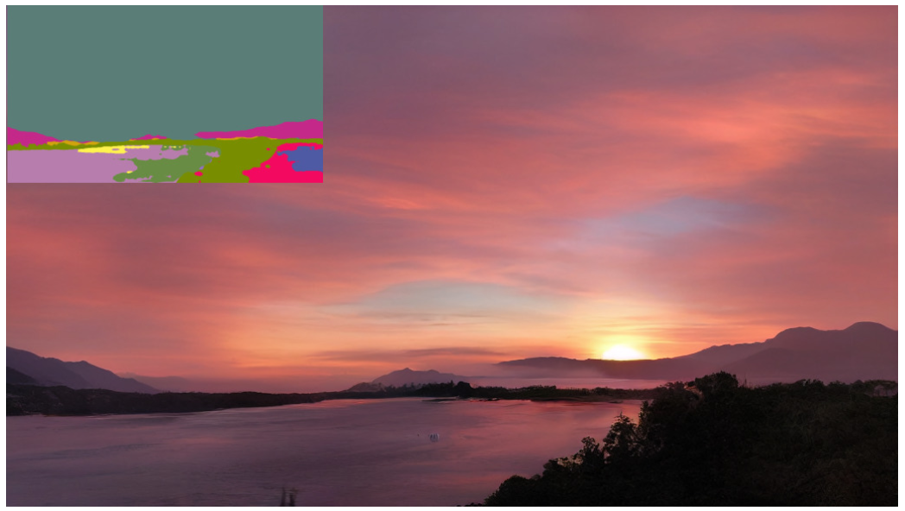
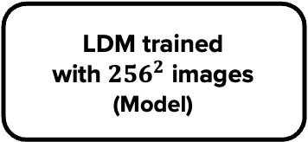
Experiments
Image-to-Image image modeling
Concatenation with spatially aligned image
(Condition)
LDM trained
with ${256}^{2}$ images
(Model)
Could generate equivalent or
larger size of images
(Led to search for Super-Resolution, Inpainting)
Result of Semantic Synthesis (512 X 1024)
C&I LAB

Slide 38
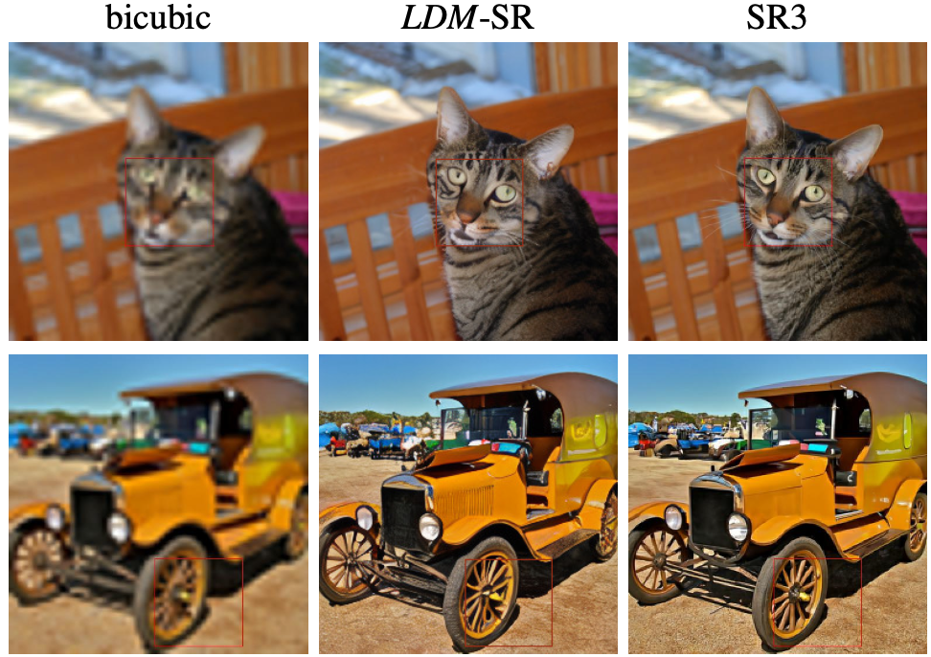
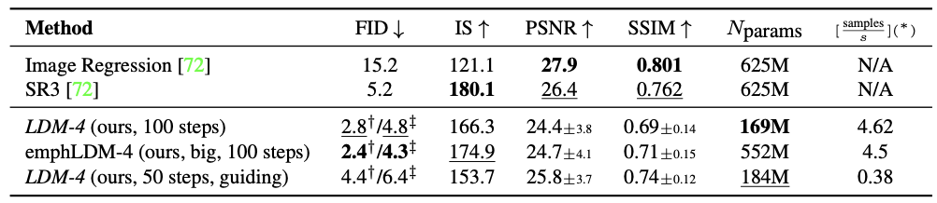
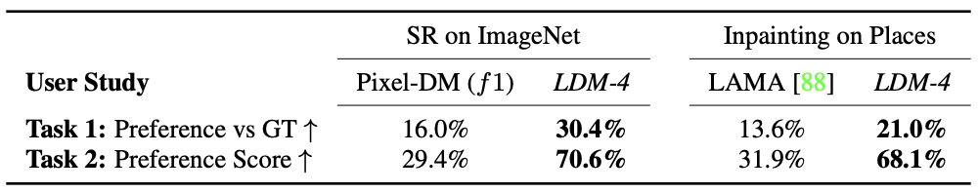
Experiments
Super-Resolution
Conditioning low-resolution images via Concatenation
(Condition)
Performance Scores of utilized methods
Human Preference Score Result
64 → 256 Super-Resolution Results
C&I LAB

Slide 39
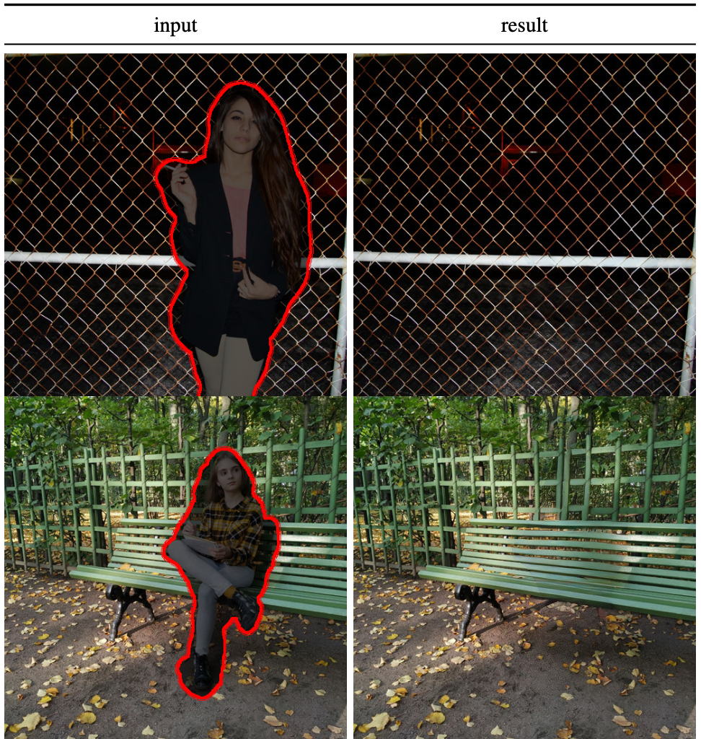
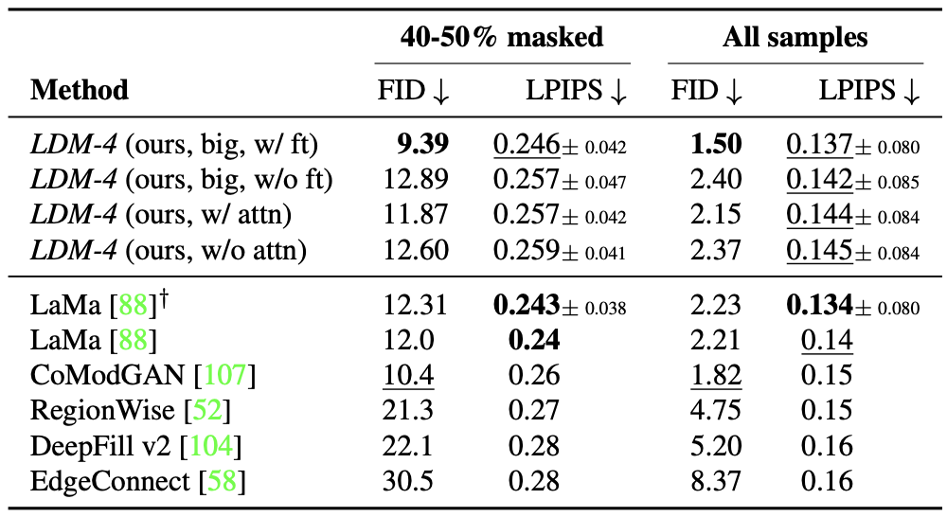
Experiments
Inpainting
Masking Region
(Condition)
Object Removal with LDM
C&I LAB

Slide 40
Thank you
C&I LAB

